Slide 1
Reintroduction of species
that have become extinct in Central Europe
due to habitat destruction
[with some successful examples of reintroduction]
Prof. Dr. Werner Kunz
University Düsseldorf
www.kunz.hhu.de/

Slide 2
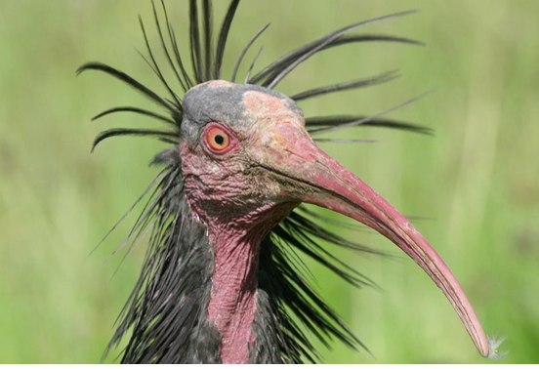
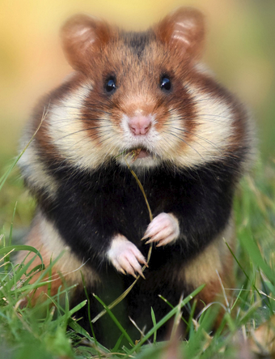
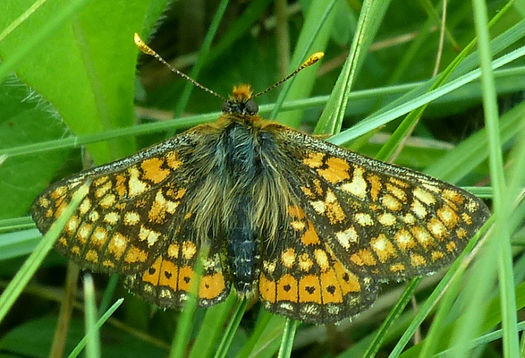
some examples of species that have been saved from extinction through
(1) breeding,
(2) habitat management and
(3) reintroduction into the wild
Google
Bald Ibis
Euphydryas aurinia
Hamster
Google

Slide 3
I am not a Zoo-scientist.
my presentation concerns on
saving endangered species in Central Europe
Why have so many species become rare or even threatened with extinction in Central Europe today?
What can be done?

Slide 4
The number of human beings on Earth
exceeded the 8 billion mark in 2022

Slide 5

There is no more room for the wild animals
Google

Slide 6
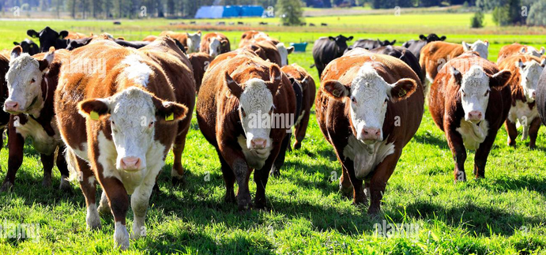
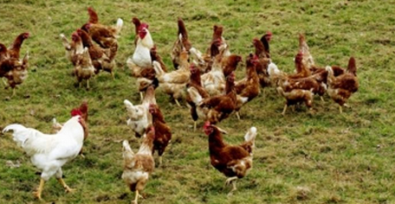
Google
there are around
1.5 billion cattle
on the planet
and around
25 billion chickens

Slide 7
This is undoubtedly the main reason why so many species are becoming extinct,
but this cause is often not mentioned in the first place

Slide 8
The decline in biodiversity in Germany goes on and on.
A visible turnaround is not recognizable,
despite nature conservation

Slide 9
Why have so many species
become rare or even threatened with extinction
in Central Europe today?

Slide 10
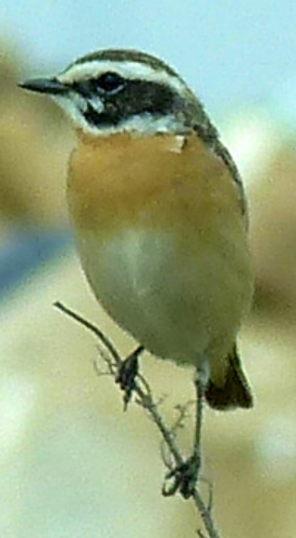
Today in Germany we only have
20 % as much “bird mass”
as in 1850.
This is a
loss of 80% in the last 2 centuries
Kunz 2.5.15

Slide 11
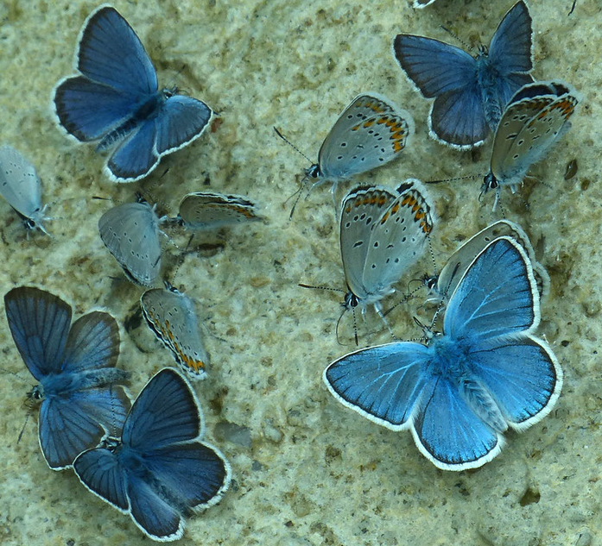
and with the insects it is even worse:
Loss of 80% “insect biomass”
in the last 30 years alone
Kunz 21560 1.6.17
Cupido minimus, Plebeius argus und Polyommatus dorylas

Slide 12
So, if we used to have in a certain area
100 insects in earlier years,
then today there are only 20 in the same area

Slide 13
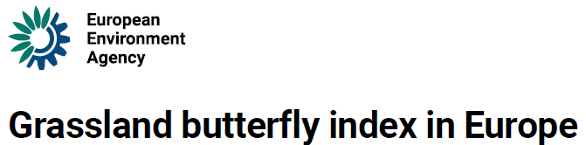
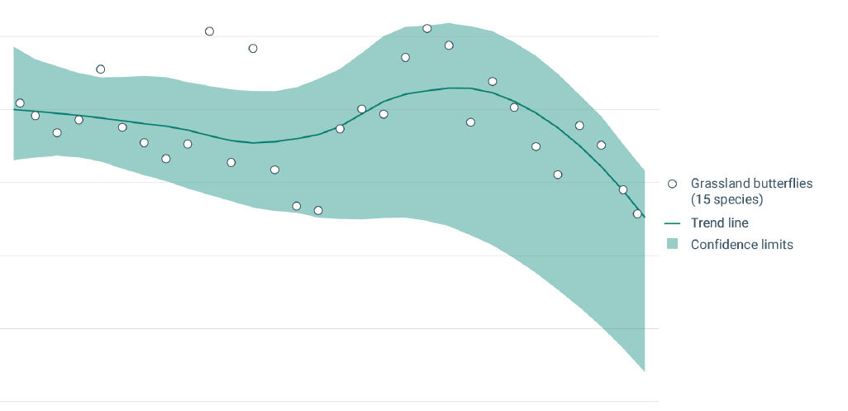
1991
2020
Drastic decline in butterflies, especially in the last 10 years
https://www.eea.europa.eu/en/analysis/indicators/grassland-butterfly-index-in-europe-1

Slide 14
What has happened ??
particularly during the last 60 years ??
There are several causes
I am focussing here on one of the causes:
We now have a landscape in Central Europe
that we never had before

Slide 15
What did the landscape in Central Europe look like in the past?
And what does it look like today?
Let's go back 2 million years into the European past

Slide 16
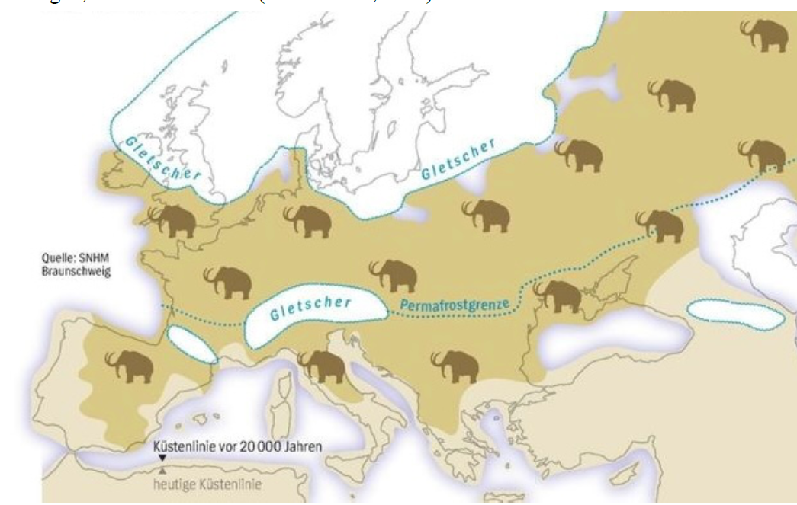
Large areas in Central Europe were for more than 2 million years
during the glacial periods
covered by the mammoth steppe
https://www.spiegel.de/wissenschaft/auferstehung-in-der-arktis-a-c8b887fb-0002-0001-0000-
000131355130

Slide 17
Many people believe
that the mammoth steppe of the glacial periods
was not habitable for many species
because of the permafrost soil
But exactly the opposite was the case:
the mammoth steppe was a very species-rich habitate
also e.g. for the cold-blooded butterfly species
[which I would like to focus on in this presentation]

Slide 18
Design of
Alena Sucháčková
Senckenberg Deutsches Entomologisches Institut Müncheberg
Suchackova et al. (2021): Extremely Endangered Butterflies of Scattered Central European Dry Grasslands Under Current Habitat Alteration.
Insect Systematics and Diversity 5 (5), Artikel 6. DOI: 10.1093/isd/ixab017
(here with Pseudophilotes bavius
and Protoerebia afra)
Meeting of the Brandenburgische Akademie „Schloss Criewen“ 2024

Slide 19
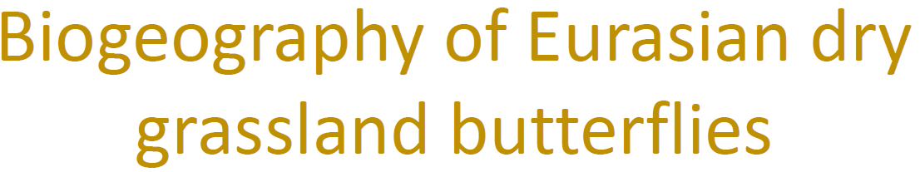
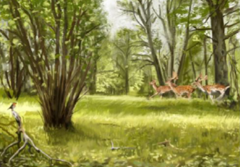
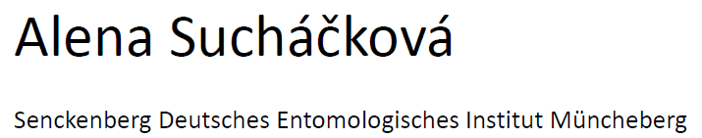
This is what the forests looked like during the interglacials:

Slide 20
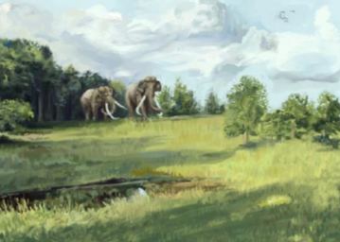
Steppes were present not only during the glacial periods, but also during the interglacials periods.
The steppes were kept clear by the large number of megaherbivores in the forests

Slide 21
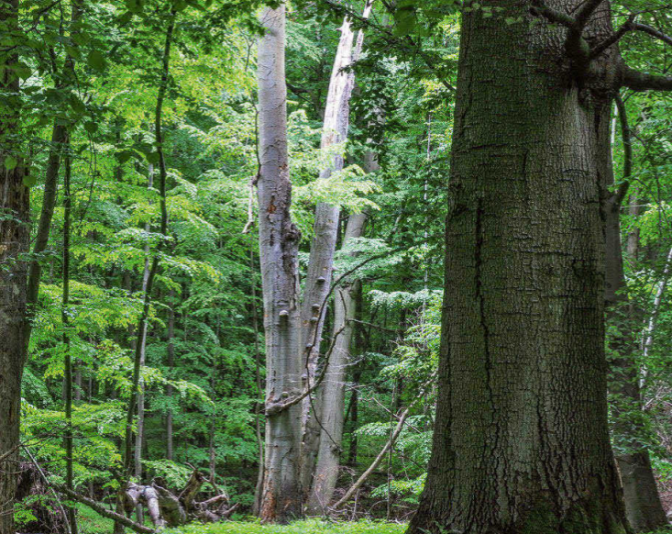
Nicht o
There was almost nowhere this kind of dark forest with a closed canopy.
In earlier millennia, the forests were always much lighter with sunny spots
Knapp et al.: Der Holzweg - Wald im Widerstreit der Interessen. oekom, 2021

Slide 22
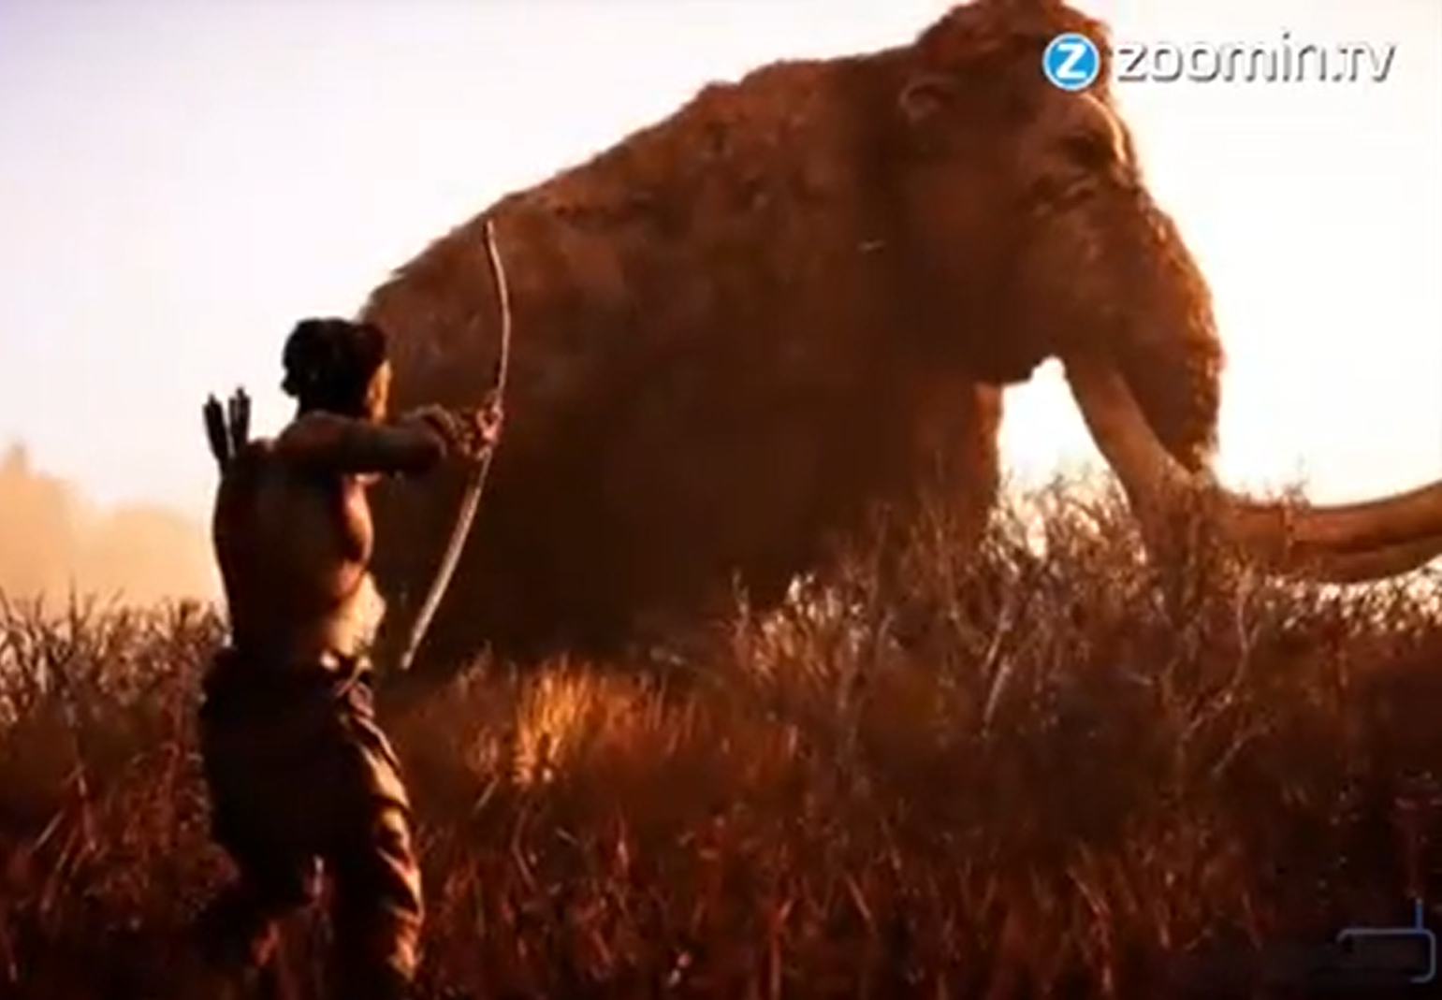
At the end of the last glacial period
(approx. 35,000 years ago)
humans wiped out most of the large herbivores
Mediathek-Video, published 27.02.2016

Slide 23
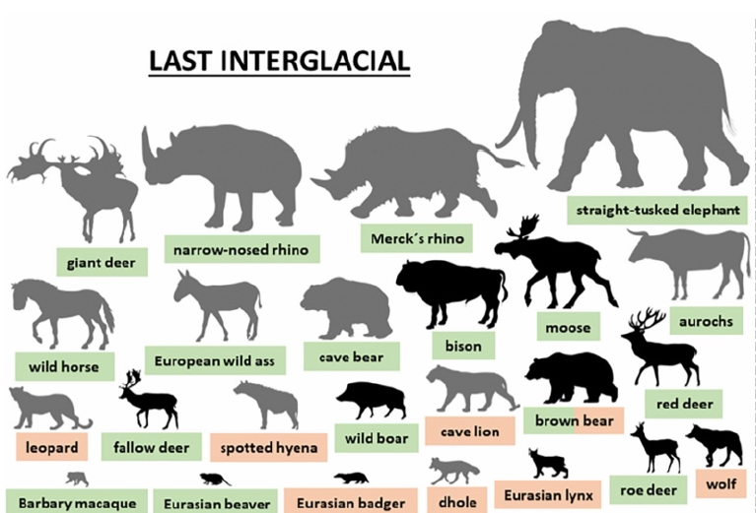
still native in the last interglacial:

Slide 24
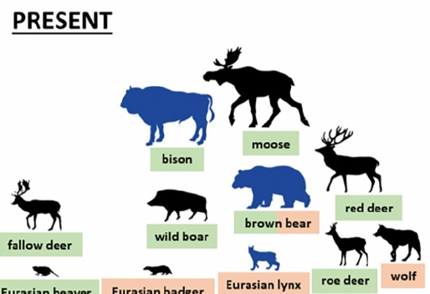
Today in the Holocene, only these few large mammals are still native :
Davoli et al. (2023). Megafauna diversity and functional declines in Europe from the Last Interglacial to the present. Global Ecology and Biogeography, 32(12), 1845–1861.
https://doi.org/10.1111/geb.13778

Slide 25
The megaherbivores were gone in the Holocene, but humans (now sedentary) took over the
role of the large mammals
and defied reforestation,
Man (instead of the large mammals)
now kept the landscape open
and prevented it
from becoming overgrown with dark forests

Slide 26
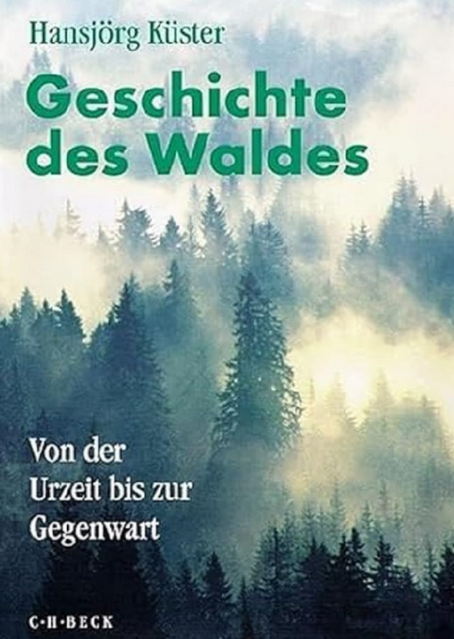
Pollen analyses
show that we had many open countries in the Neolithic Age

Slide 27
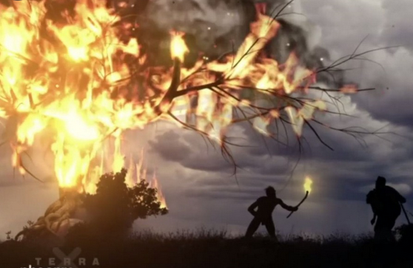
Google

Slide 28
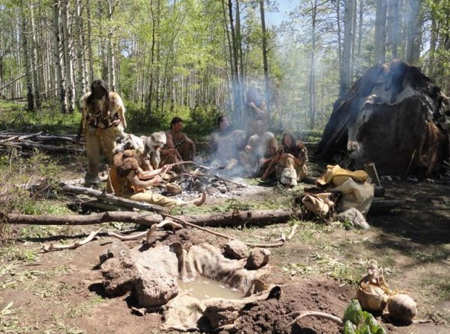
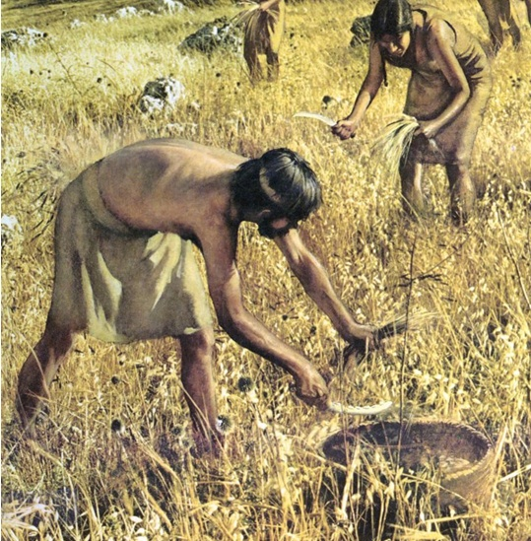
Google

Slide 29
For thousands of years
(until a hundred years ago)
the central European landscape was
always an open land
- not so densely overgrown with grass
- not so overgrown with shrubs
- the forests were open forests with sunlight on the ground

Slide 30
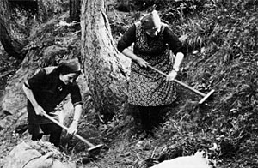

historical utilisation:
the forests were ‘cleared’
Litter for the cowshed

Slide 31
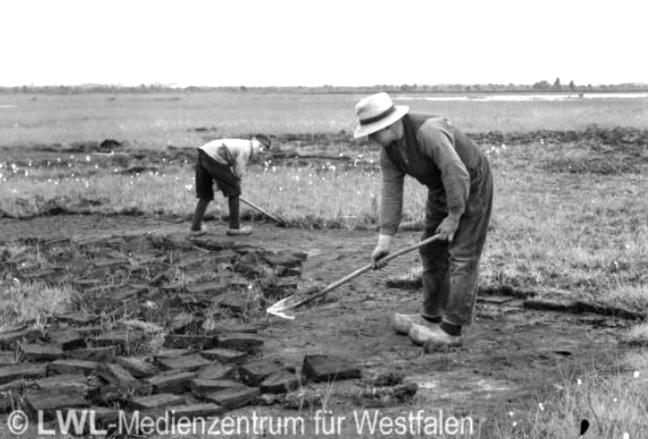
topsoil removal (“Plaggenwirtschaft”):
removal of the humus layer as bedding for the cattle sheds
Zwillbrocker Venn bei Vreden, Mai 1936
(LWL-Museum für Naturkunde Münster)

Slide 32
What did the landscape in Germany
look like in the last centuries?

Slide 33
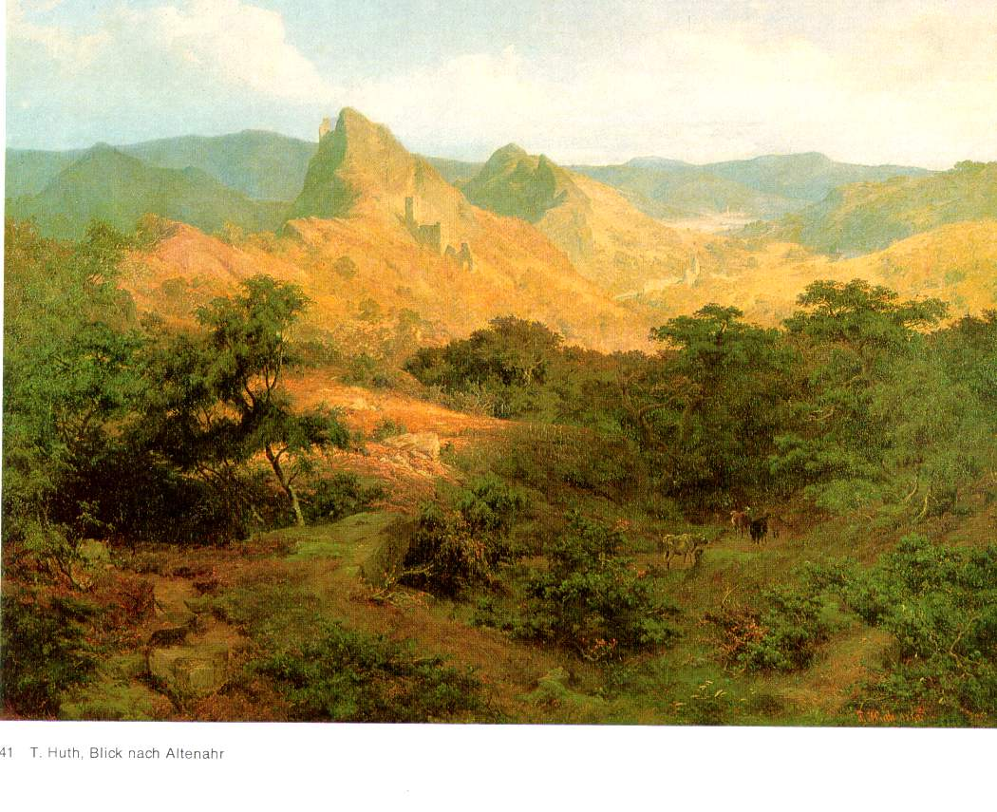
Ahrtal near Altenahr 1842
Tauch M (1974):
'Rheinische Landschaften - Gemälde und Aquarelle aus dem 19. und 20. Jahrhundert.' (Gesellschaft für Buchdruckerei A.G.: Neuss)

Slide 34
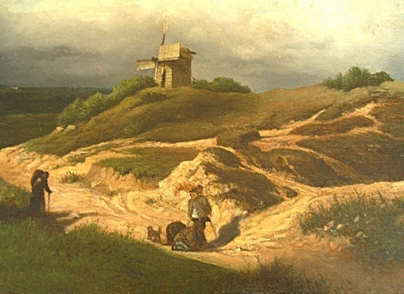
1870: Landscape in Thüringen Foto privat

Slide 35
These are the landscapes
to which most animals in Central Europe are adapted.
Not the dense forests
One thing is certain today:
We lost our open landscape

Slide 36
One of the main reasons for today's species decline
in Central Europe is:
1.) eutrophication
(nitrogen fertilisation from the atmosphere) and
2.) lack of utilisation
of all areas outside agricultural land
that's why everything is overgrown today

Slide 37
we have too much afforestation
3/5 of the 436 European butterfly species
use dry grassland as the most important habitat

Slide 38
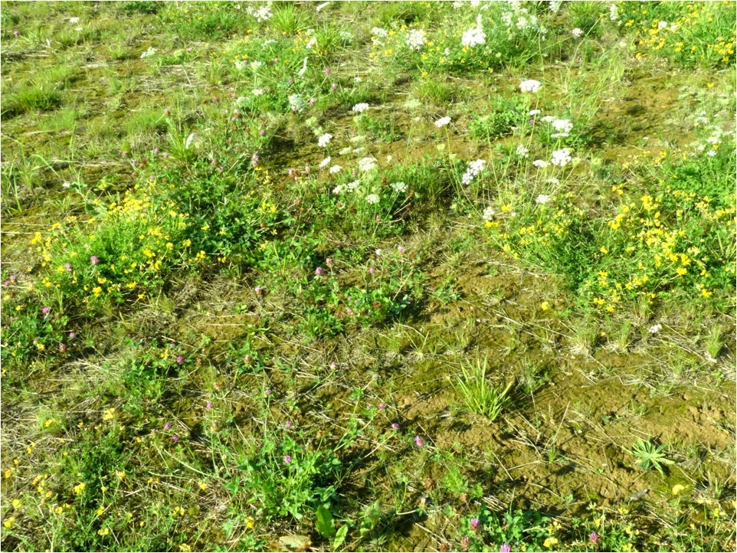
Meadow in earlier times

Slide 39
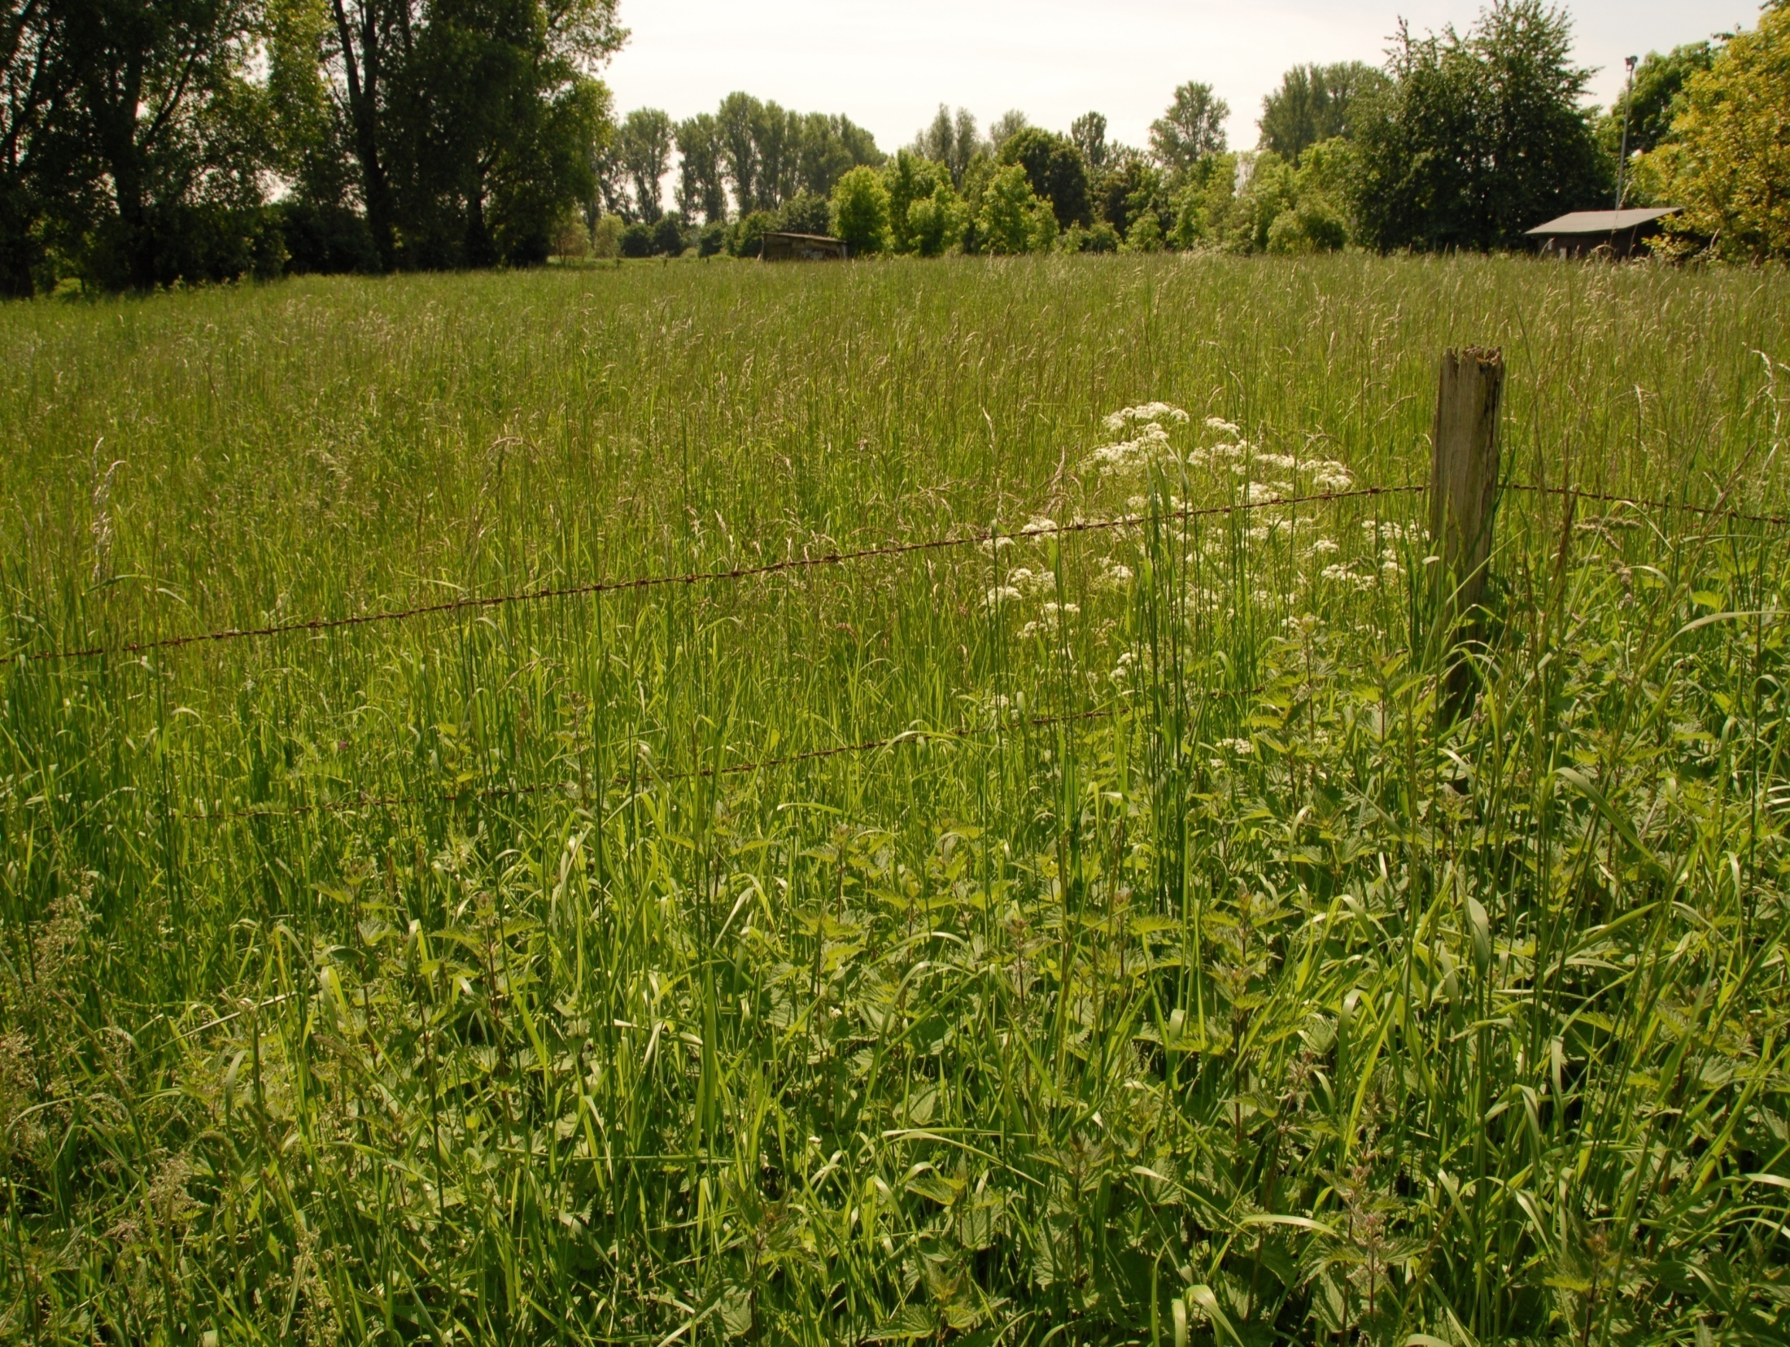
Meadow today
Kunz 10314

Slide 40
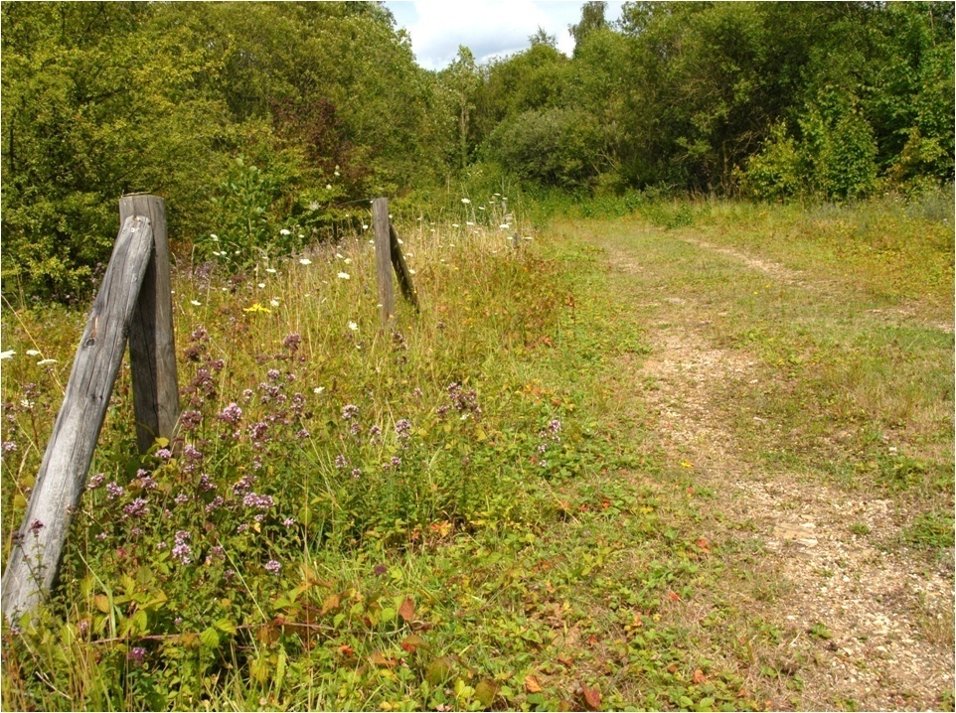
Wayside in earlier times
10191
10191
21147

Slide 41
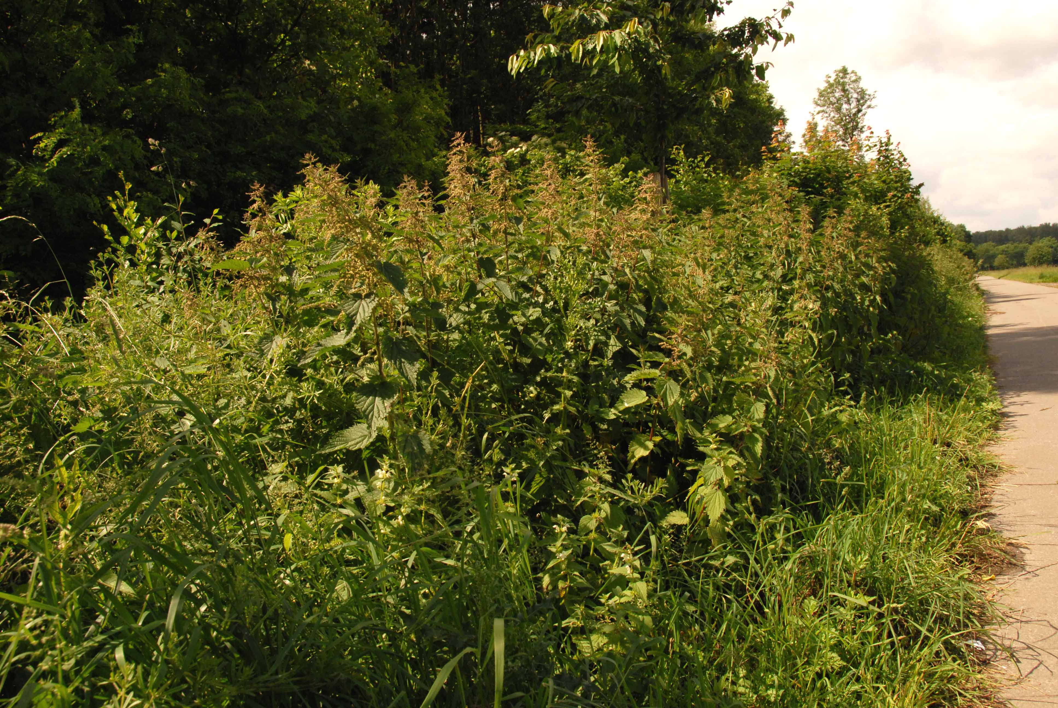
Wayside today
Kunz 10305

Slide 42
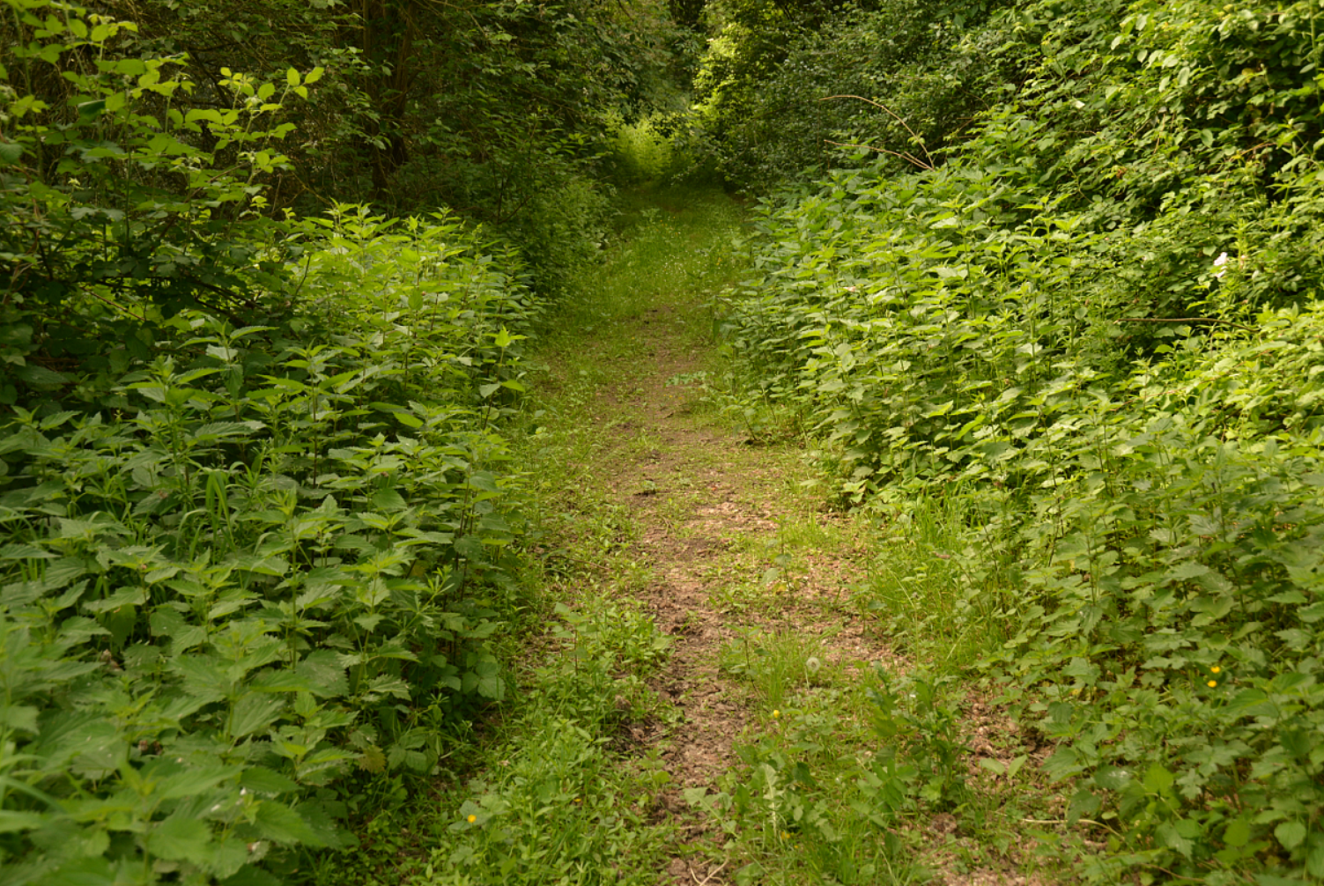
Wayside today
Kunz 23156

Slide 43
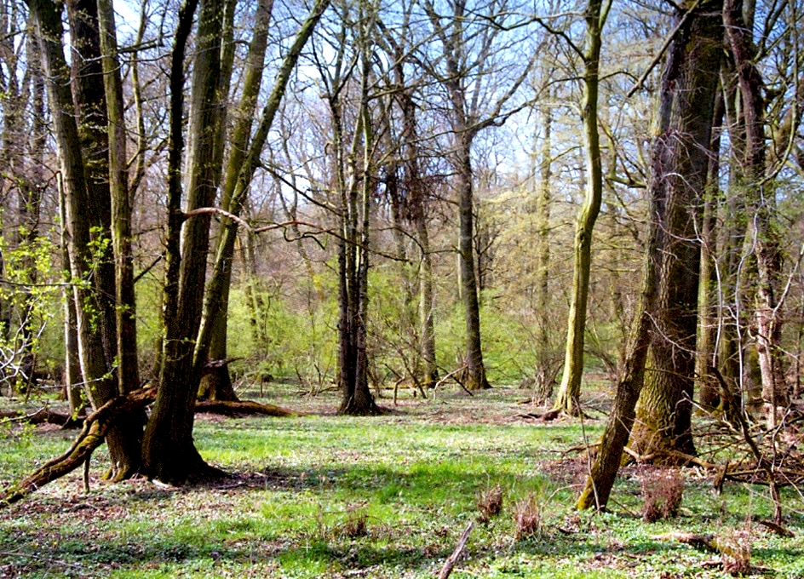
Forest in earlier times
Foto: Reichhoff 6728

Slide 44
Forest today
Knapp et al.: Der Holzweg - Wald im Widerstreit der Interessen. oekom, 2021

Slide 45
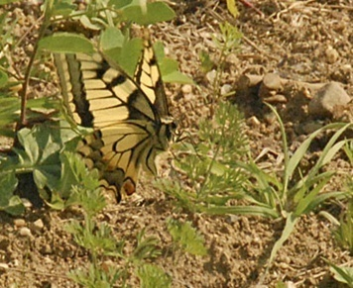
Many butterfly species need sparsely vegetated soils
to lay their eggs

Slide 46
Many butterfly species are close to extinction in Germany,
because they no longer have any open ground
(no sparse vegetation)

Slide 47
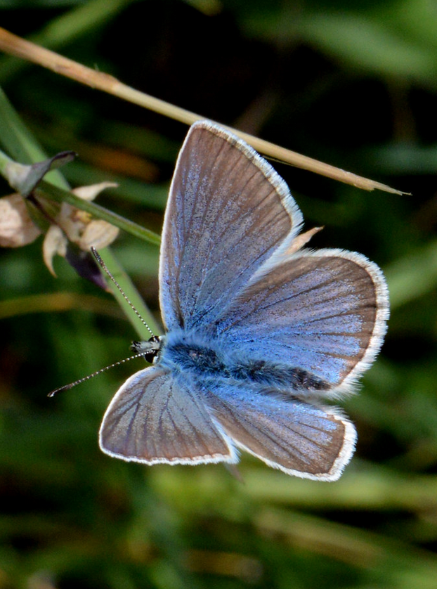
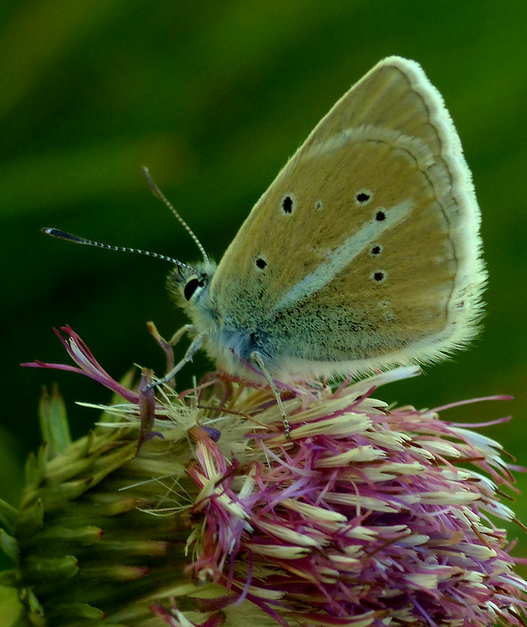
Example:
the Blue butterfly Polyommatus damon
Kunz 15829
Kunz 15822

Slide 48
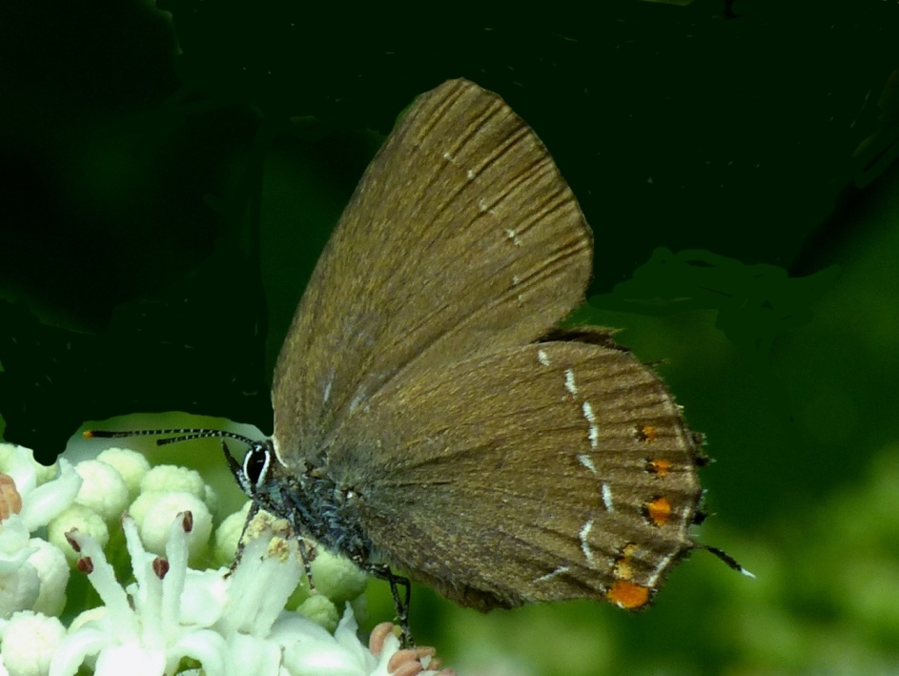
Example:
the hairstreak Satyrium ilicis:
Werner Kunz 25.06.2014 13905

Slide 49
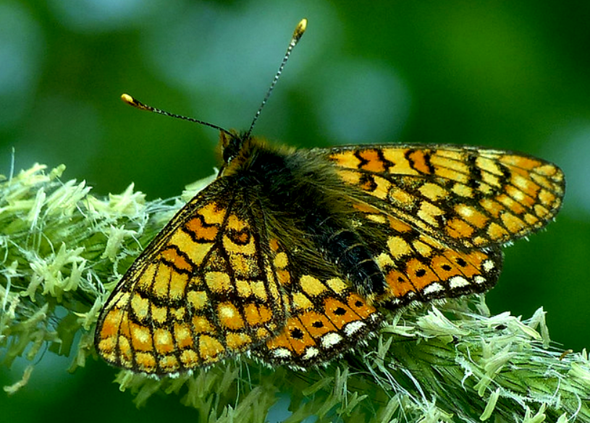
Example:
the Fritillary Euphydryas aurinia
Kunz 21879

Slide 50
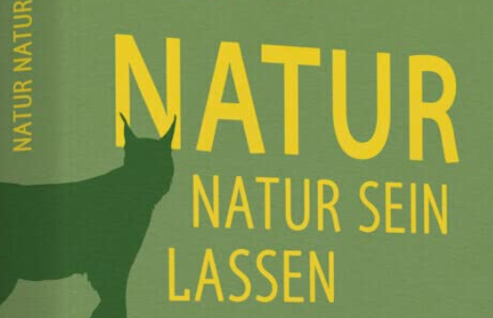
Today, we can no longer save many species
by letting nature run its course
Bestseller in Germany 2017
This desire would be the wrong solution
for saving a number of endangered species

Slide 51
Man’s wishful dream for ‘unspoilt nature’
does not save many species that are close to extinction.
Today, mankind has the moral obligation,
but also the technical means,
to restore lost habitats

Slide 52
This is what species conservation
must look like in the future:

Slide 53
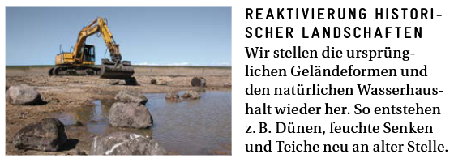
Here an EU-life-project:
https://www.stiftungsland.de/was-wir-tun/erfolgreiche-hilfe-fuer-die-natur/life-aurinia-lebensraum-fuer-schmetterlinge/:
what they do: “Restoration of historical landscapes:
We restore the original landforms. In this way, heathlands and dunes are recreated in their original location

Slide 54
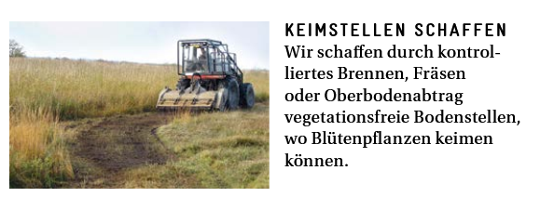
We create vegetation-free areas through
(1) controlled burning, (2) topsoil removal.
We create vegetation-free areas where flowering plants can grow
https://www.stiftungsland.de/was-wir-tun/erfolgreiche-hilfe-fuer-die-natur/life-aurinia-lebensraum-fuer-schmetterlinge/

Slide 55
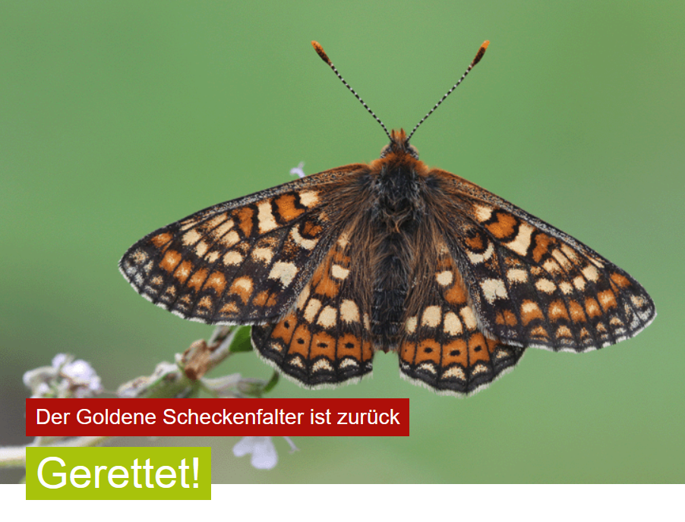

TheEU-life-project saved this species:
https://www.stiftungsland.de/was-wir-tun/erfolgreiche-hilfe-fuer-die-natur/life-aurinia-lebensraum-fuer-schmetterlinge/

Slide 56
This formerly common species
was completely extinct in Schleswig-Holstein
It could be successfully reintroduced through:
1.) breeding under artificial conditions
2.) rigorous technical habitat management and
3.) releasing the bred animals into the wild
like this:

Slide 57
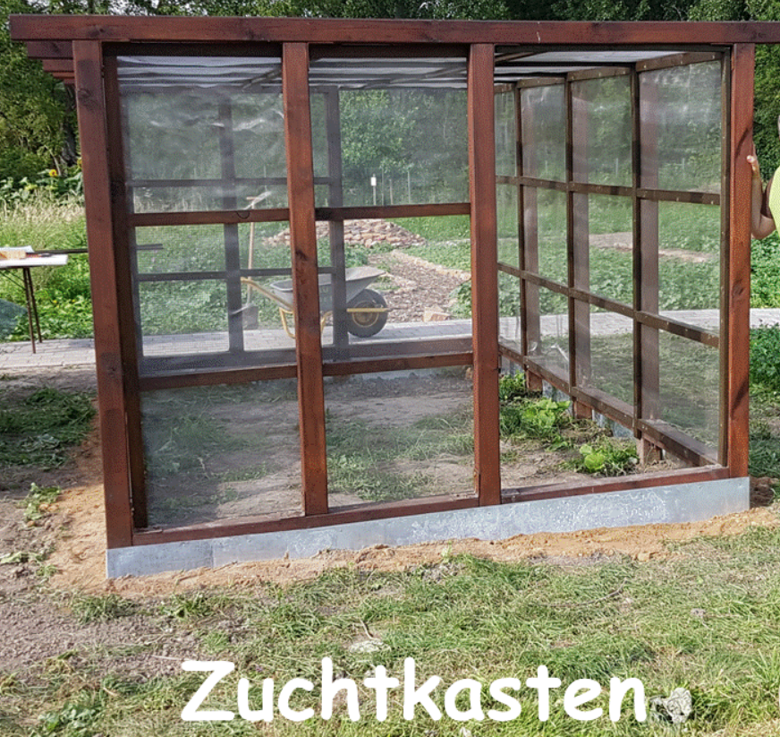
Step 1: Breeding of caterpillars and butterflies

Slide 58
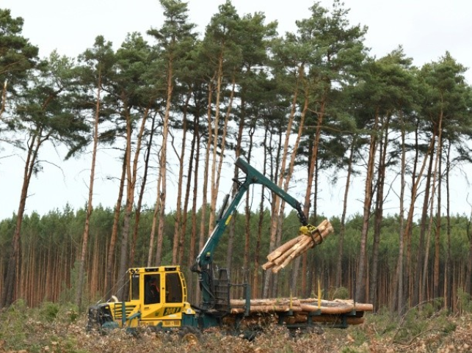
Step 2: The forest had to be removed
(which of course was only possible under protests of the population)
https://www.stiftungsland.de/was-wir-tun/erfolgreiche-hilfe-fuer-die-natur/life-aurinia-lebensraum-fuer-schmetterlinge/

Slide 59
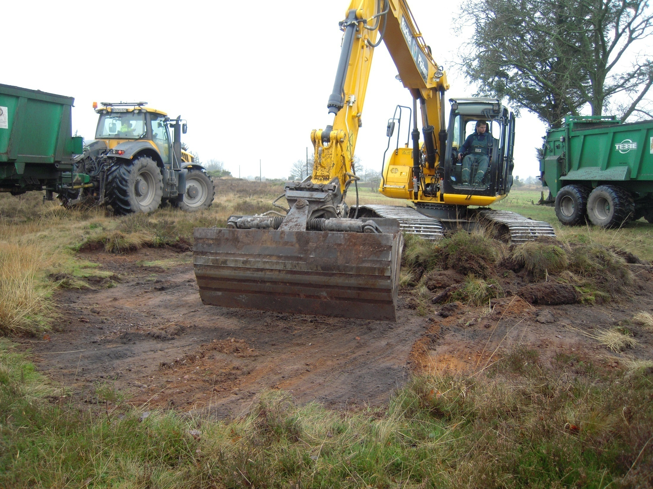
Step 3: Then the humus had to be removed
(this also was only possible due to protests from environmentalists)

Slide 60
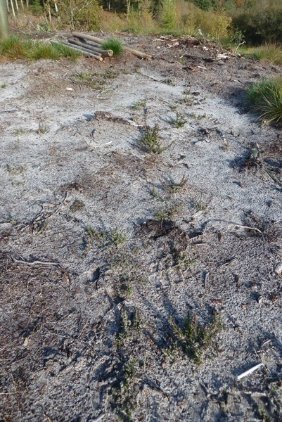
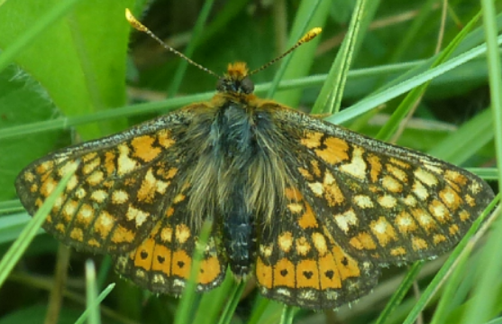
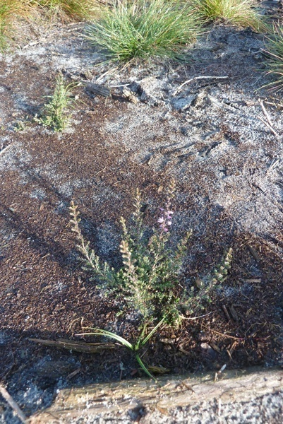
In the end, the habitat looked like this:
Kunz 21141
Step 4: the fritillary butterfly could be successfully reintroduced there

Slide 61
Kunz 21140

Slide 62
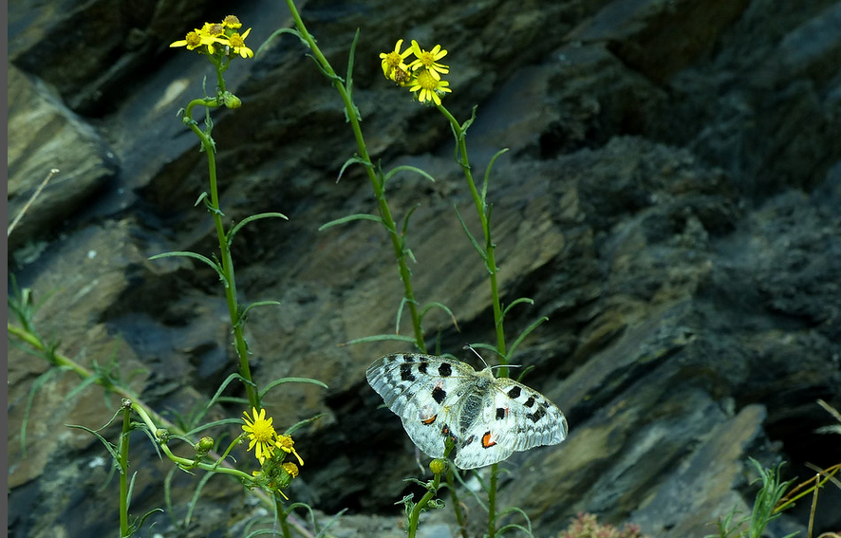
The next example is the Apollo butterfly on the Moselle
Parnassius apollo vinningensis
Kunz 13225

Slide 63
This butterfly is dying out at the moment
It is now to be saved through
extensive conservation breeding
We have no other choice

Slide 64


